Slide 1
BUSINESS ANALYTICS SUPERSTORE USING TABLEAU

Slide 2
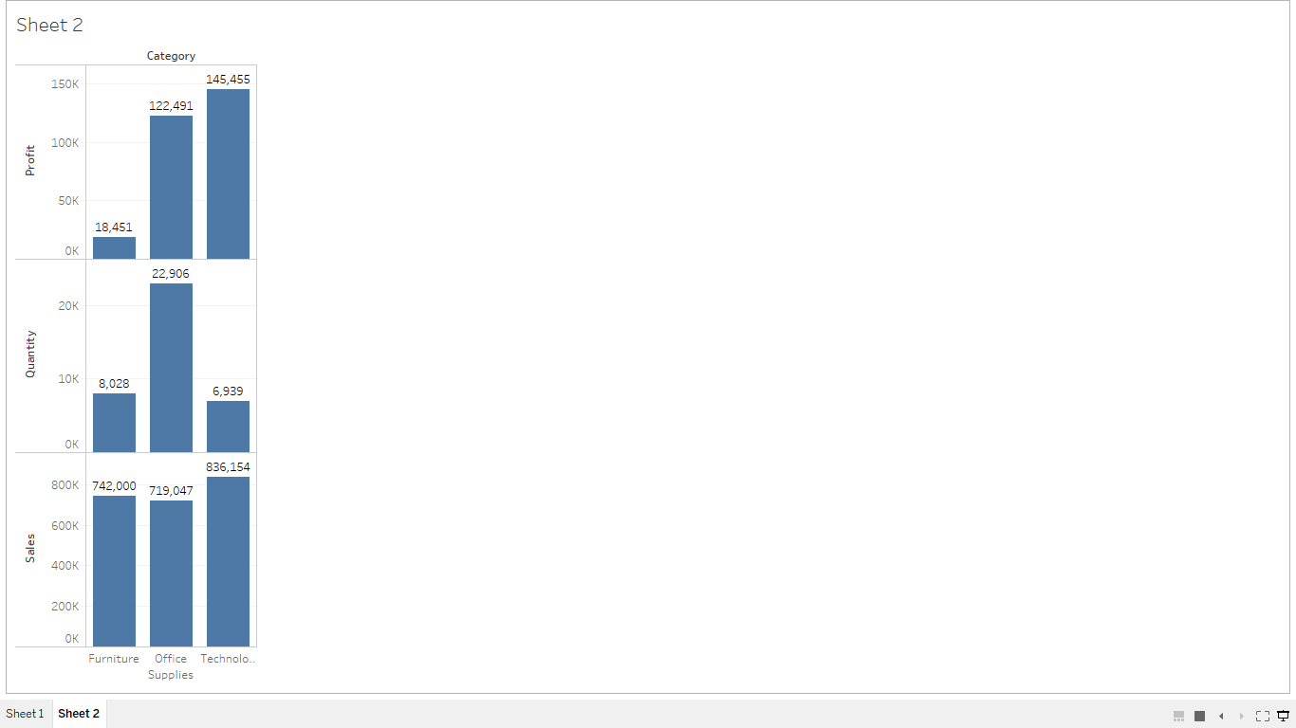
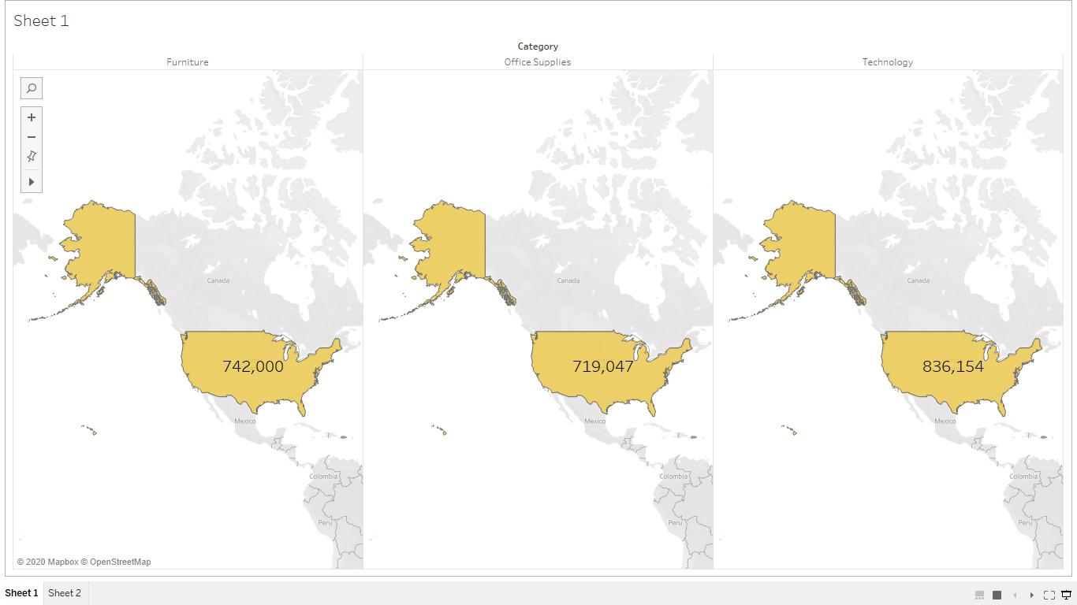
THE BAR GRAPH COMPARES THE SUPPLY CATEGORY FURNITURE , OFFICE AND TECHNOLOGY
INTERPRETATION :
TECHNOLOGY SUPPLIES HAVE HIGH PROFIT AND SALES
OFFICE SUPPLIES HAVE HIGHER QUANTITY
STORE SHOULD FOCUS ON INCREASING QUANTITY OF TECHNOLOGY SUPPLIES TO GET MORE PROFITS
THE MAP SHOWS HIGH SALES OF TECHNOLOGY SUPPLIES

Slide 3
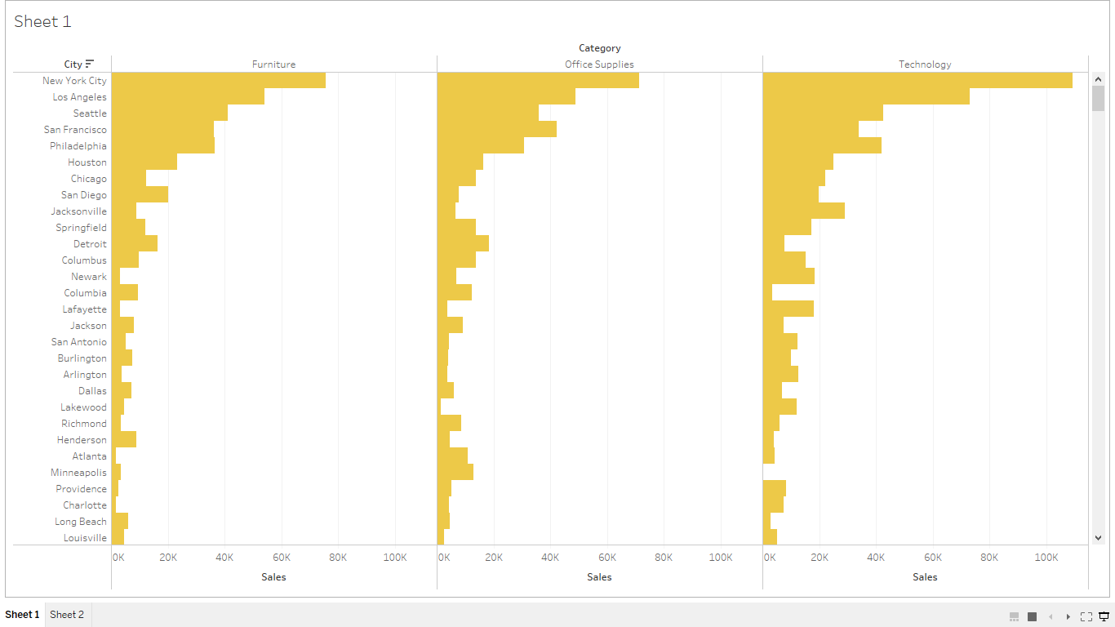
NEW YORK CITY SHOWS HIGH SALES IN ALL CATEGORIES .

Slide 4
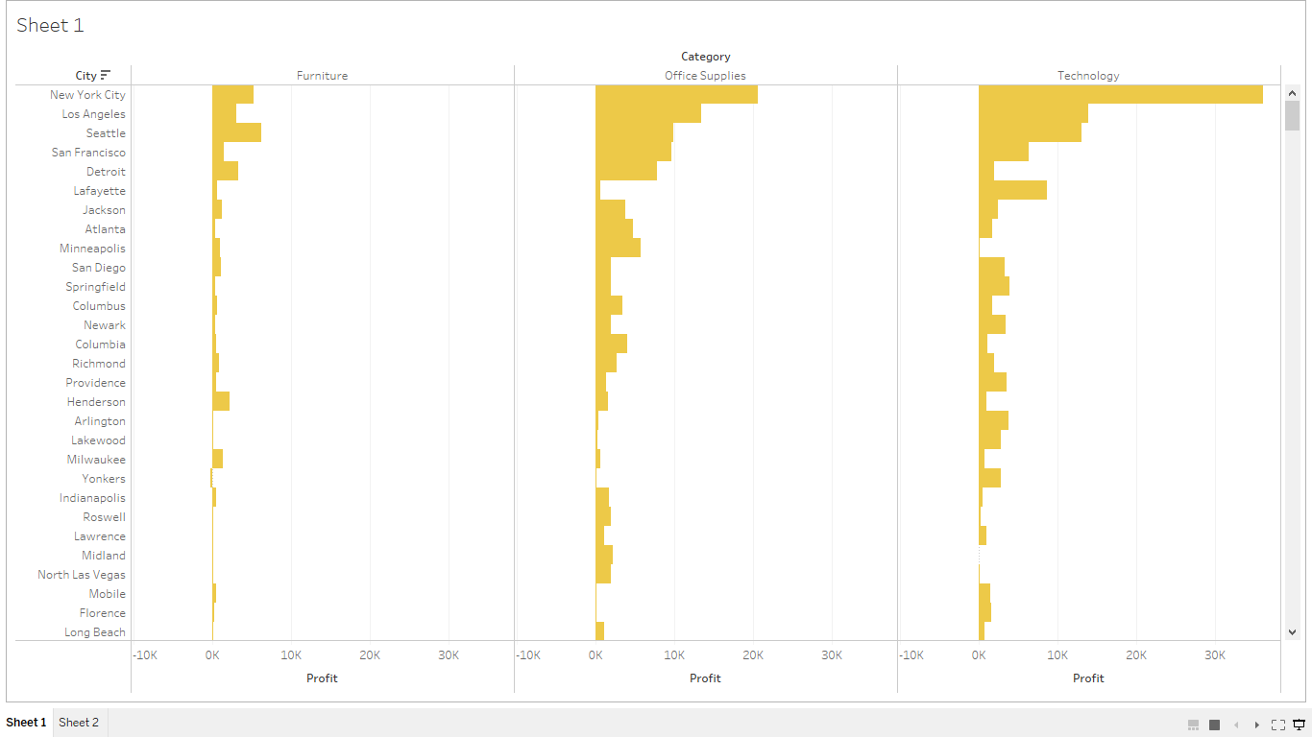
NEW YORK CITY SHOWS HIGH PROFITS IN ALMOST ALL CATEGORY OF SUPPLIES.
SEATTLE SHOWS HIGH PROFITS IN FURNITURE CATEGORY.

Slide 5
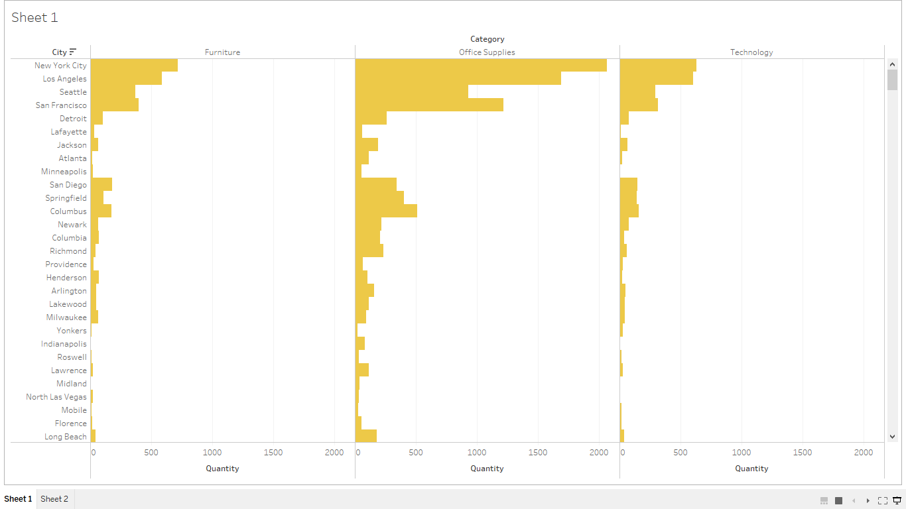
NEW YORK CITY SHOWS HIGH QUANTITY IN ALMOST ALL CATEGORY OF SUPPLIES.

Slide 6
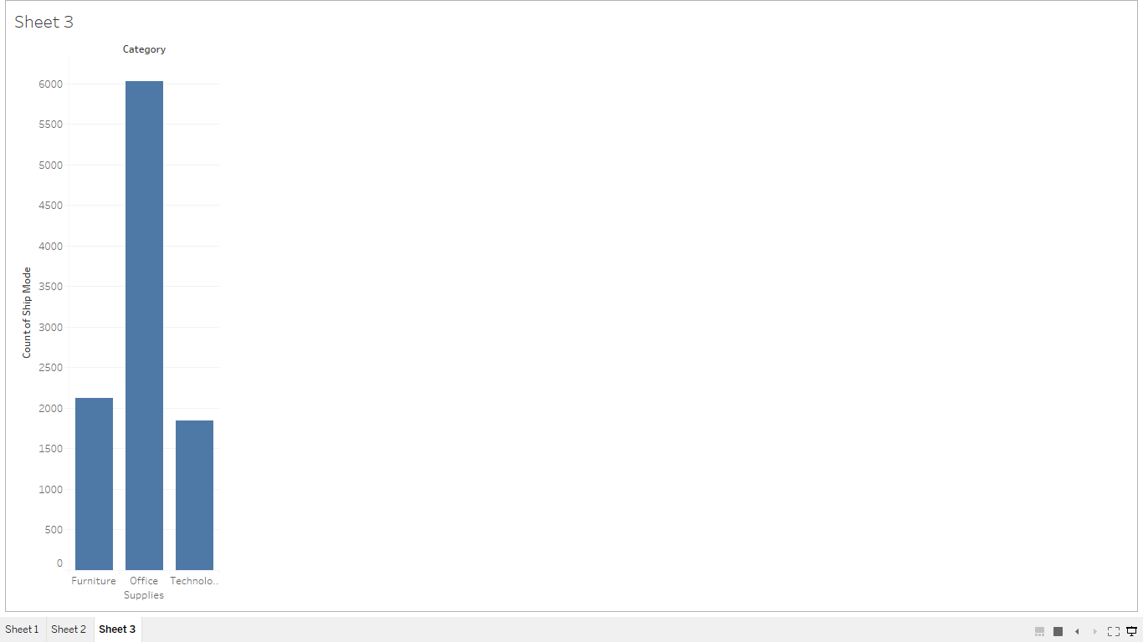
FOR OFFICE SUPPLIES SHIPPING MODE IS MORE FAVOURABLE.

Slide 7
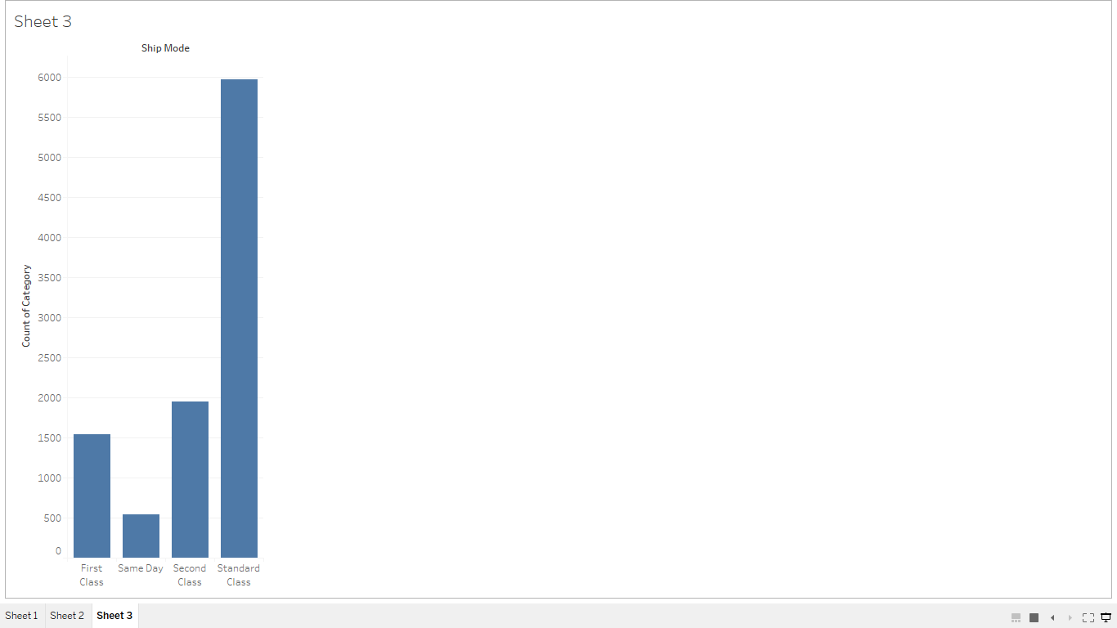
FOR ALL SUPPLIES SHIPPING MODE IS HIGH IN STANDARD CLASS

Slide 8
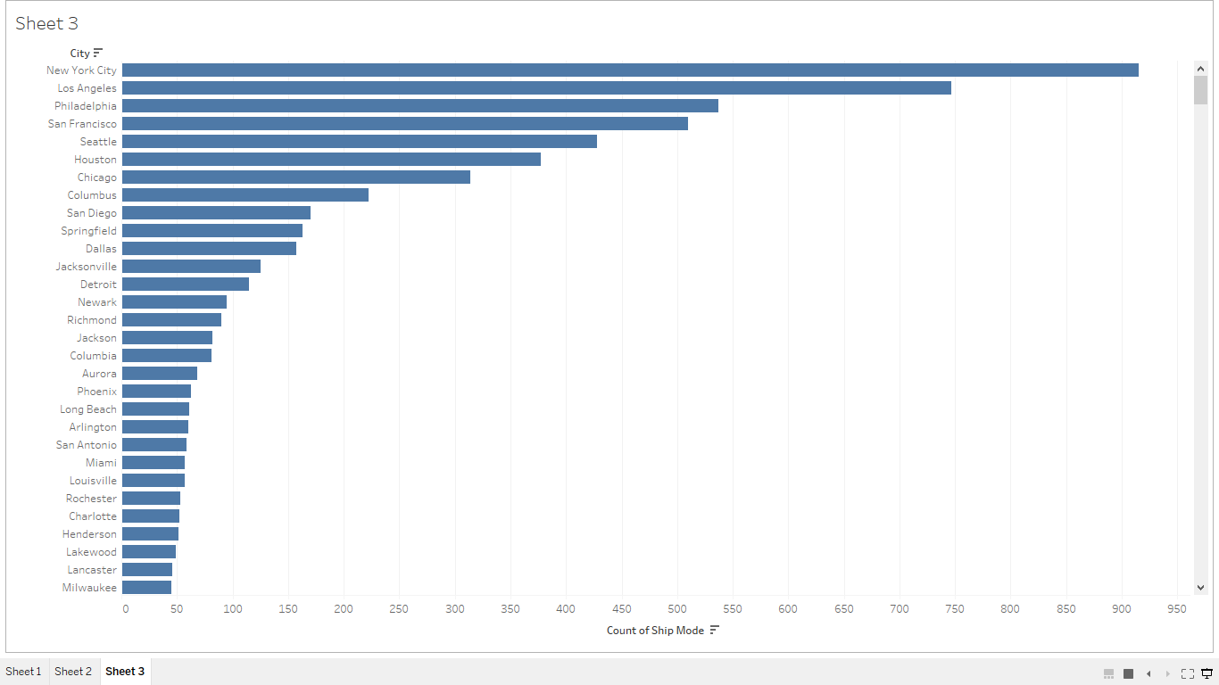
SHIPPING MODE IS MORE IN NEW YORK CITY WHICH IS PROPOTIONAL TO INCREASE IN QUANTITY AND SALES

Slide 9
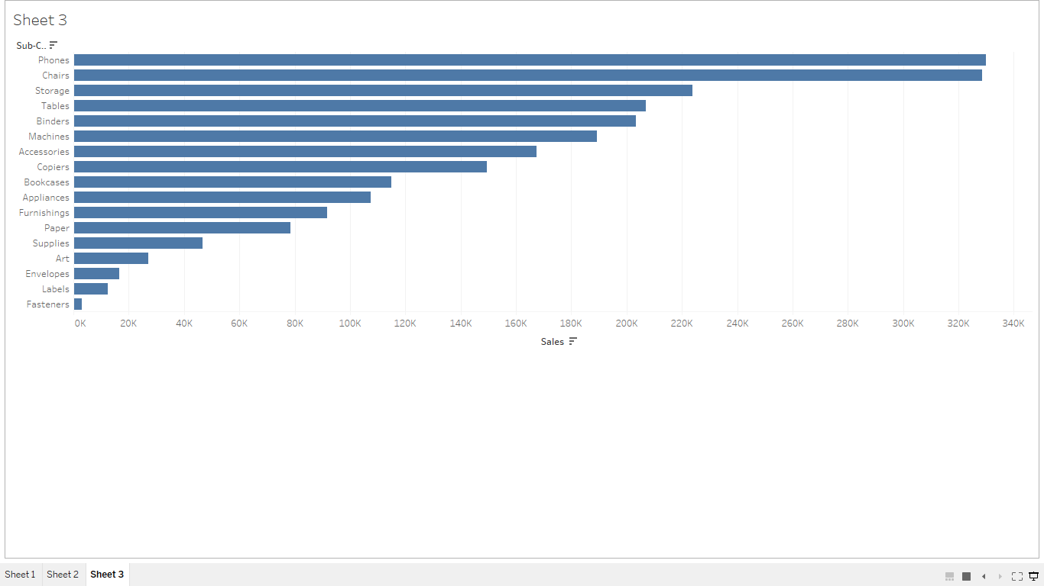
IN SUB CATEGORY SECTION PHONES HAVE SHOWN HIGH SALES

Slide 10
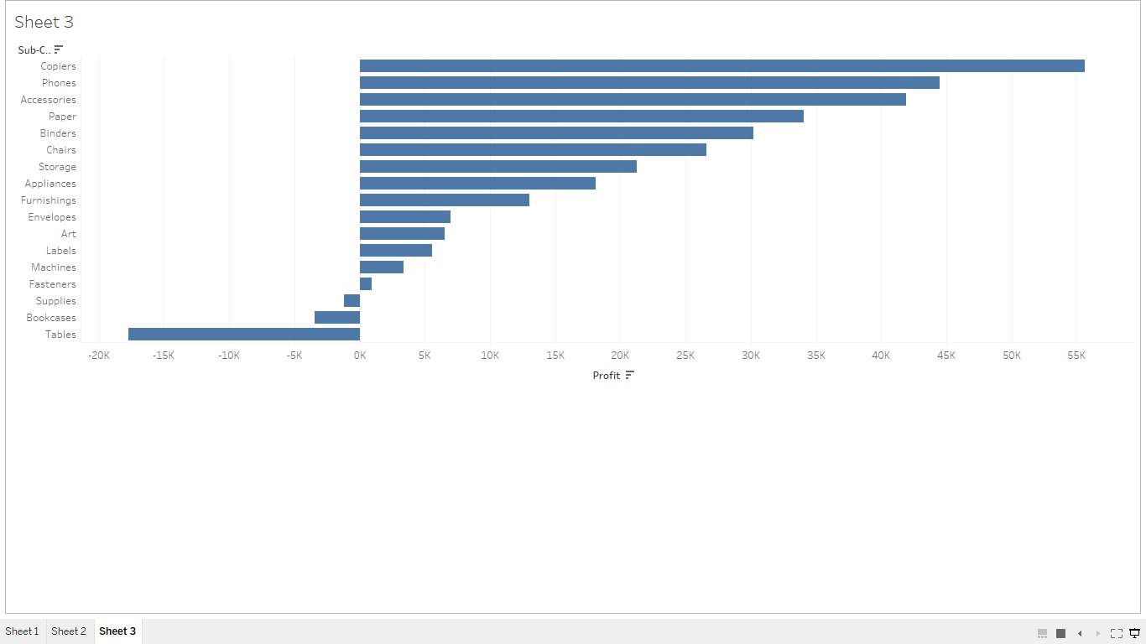
COPIERS HAS SHOWN HIGH PROFITS

Slide 11
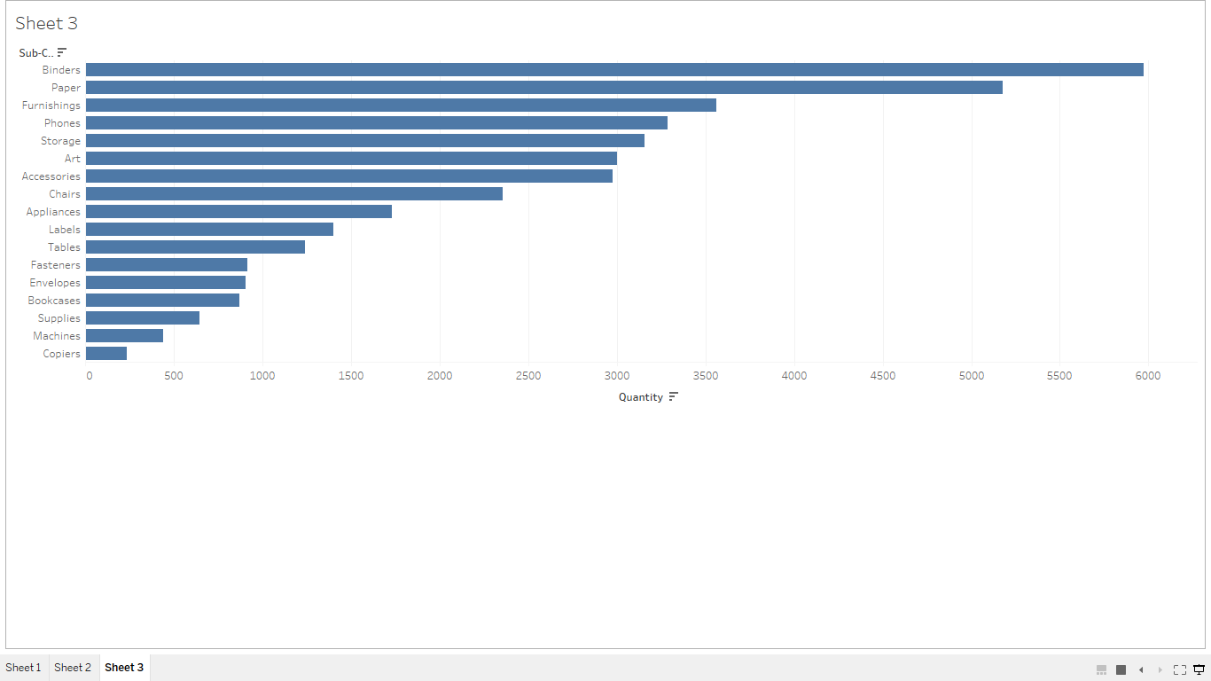
BINDERS HAVE SHOWN HIGH QUANTITY OF ITEMS SOLD

